Slide 1
Unit-VI
Distributed Database
Contents:
Introduction to Distributed Database, Features of DDBS, Design Issues in DDBS, Distributed Database Design Concept, Objectives, Data Fragmentation, Transparencies in Distributed Database Design.
Course Outcome:
Summarize the concepts of Distributed Database.

Slide 3
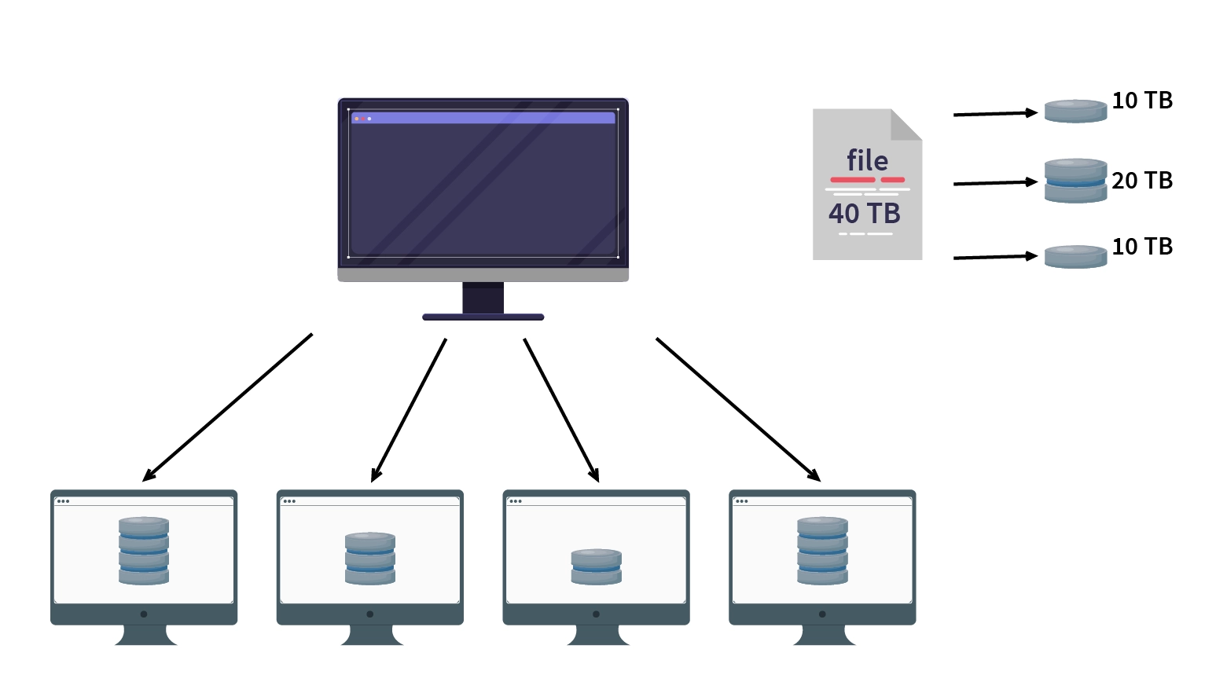

Slide 4
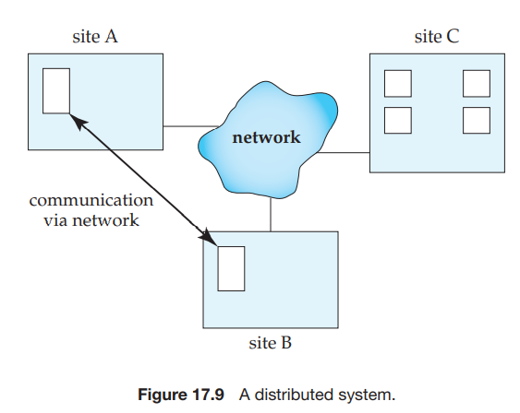
Collection of multiple, logically related database (but physically separated) distributed over a network.
Fundamental Principle: Making database transparent to the user.
(detail design of D/B is hidden from user)

Slide 5
An Example of a Distributed Database
Consider a banking system consisting of four branches in four different cities.
Each branch has its own computer, with a database of all the accounts maintained at that branch. Each such installation is thus a site. There also exists one single site that maintains information about all the branches of the bank.
To illustrate the difference between the two types of transactions—local and global—at the sites,
consider a transaction to add $50 to account number A-177 located at the Valleyview branch. If the transaction was initiated at the Valleyview branch, then it is considered local; otherwise, it is considered global.
A transaction to transfer $50 from account A-177 to account A-305, which is located at the Hillside branch, is a global transaction, since accounts in two different sites are accessed as a result of its execution.

Slide 6
Introduction
Distributed database is a database that is not limited to one computer system. It is like a database that consists of two or more files located in different computers or sites either on the same network or on an entirely different network.
These sites do not share any physical component. Distributed databases are needed when a particular data in the database needs to be accessed by various users globally. It needs to be handled in such a way that for a user it always looks like one single database.
By contrast, a Centralized database consists of a single database file located at one site using a single network.
Logically connected single database and that will be dispersed to different sites/ nodes (connected by computer communication network)

Slide 7
Features of Distributed Databases
Collection of logically related shared data
Data split into number of fragments.
Fragments can be replicated in distributed system
Fragments/ replicas can be allocated to different sites
In distributed system sites are linked by communication network
Data at each site is under the control of DBMS
DBMS at each site has its own right, i. e. it can handle its local application independently
Each DBMS in distributed system must have at least one global application.

Slide 8
Features of Distributed Databases
In general, distributed databases include the following features:
Location independency: Data is independently stored at multiple sites and managed by independent Distributed database management systems (DDBMS).
Network linking: All distributed databases in a collection are linked by a network and communicate with each other.
Distributed query processing: Distributed query processing is the procedure of answering queries (which means mainly read operations on large data sets) in a distributed environment.
Query processing involves the transformation of a high-level query (e.g., formulated in SQL) into a query execution plan (consisting of lower-level query operators in some variation
Hardware independent: The different sites where data is stored are hardware-independent. There is no physical contact between these distributed databases which is accomplished often through virtualization.
Distributed transaction management: Distributed database provides a consistent distribution through commit protocols, distributed recovery methods, and distributed concurrency control techniques in case of many transaction failures.

Slide 9
Applications of Distributed Database:
It is used in Corporate Management Information System.
It is used in multimedia applications.
Used in Military’s control system, Hotel chains etc.
It is also used in manufacturing control system.
ATM system
Airline reservation
E-commerce management (amazon, online banking)
The information system (search engine, Wikipedia, social networking-twitter)
Creative industries and entertainment (online gaming, music, you tube channels)

Slide 10
Advantages of Distributed Databases
Following are the advantages of distributed databases over centralized databases.
Modular Development − If the system needs to be expanded to new locations or new units, in centralized database systems, the action requires substantial efforts and disruption in the existing functioning. However, in distributed databases, the work simply requires adding new computers and local data to the new site and finally connecting them to the distributed system, with no interruption in current functions. (Easier and more economical system expansion)
More Reliable − In case of database failures, the total system of centralized databases comes to a halt. However, in distributed systems, when a component fails, the functioning of the system continues may be at a reduced performance. Hence DDBMS is more reliable.
Better Response − If data is distributed in an efficient manner, then user requests can be met from local data itself, thus providing faster response. On the other hand, in centralized systems, all queries have to pass through the central computer for processing, which increases the response time.
Lower Communication Cost − In distributed database systems, if data is located locally where it is mostly used, then the communication costs for data manipulation can be minimized. This is not feasible in centralized systems.
No more bottle-neck (improved performance)

Slide 11
Disadvantages / Adversities of Distributed Databases
Need for complex and expensive software − DDBMS demands complex (proper coordination among the sites) and often expensive software to provide data transparency and co-ordination across the several sites. (more difficult to implement a distributed database system)
Increased Processing overhead − Even simple operations may require a large number of communications and additional calculations to provide uniformity in data across the sites. The exchange of messages and the additional computation required to achieve inter-site coordination are a form of overhead that does not arise in centralized systems.
Data integrity − The need for updating data in multiple sites pose problems of data integrity.
Overheads for improper data distribution − Responsiveness of queries is largely dependent upon proper data distribution. Improper data distribution often leads to very slow response to user requests.
Greater potential for bugs. Since the sites that constitute the distributed system operate in parallel, it is harder to ensure the correctness of algorithms, especially operation during failures of part of the system, and recovery from failures. The potential exists for extremely subtle bugs.

Slide 12
Additional Functions of Distributed Databases Distribution leads to increased complexity in the system design and implementation.
Keeping track of data distribution. The ability to keep track of the data distribution, fragmentation, and replication by expanding the DDBMS catalog.
Distributed query processing. The ability to access remote sites and transmit queries and data among the various sites via a communication network.
Distributed transaction management. The ability to devise execution strategies for queries and transactions that access data from more than one site and to synchronize the access to distributed data and maintain the integrity of the overall database.

Slide 13
Additional Functions of Distributed Databases Distribution leads to increased complexity in the system design and implementation.
Replicated data management. The ability to decide which copy of a replicated data item to access and to maintain the consistency of copies of a replicated data item.
Distributed database recovery. The ability to recover from individual site crashes and from new types of failures, such as the failure of communication links.
Security. Distributed transactions must be executed with the proper management of the security of the data and the authorization/access privileges of users.
Distributed directory (catalog) management. A directory contains information (metadata) about data in the database. The directory may be global for the entire DDB, or local for each site. The placement and distribution of the directory are design and policy issues. These functions themselves increase the complexity.

Slide 14
Design Issues of Distributed System
The challenges that are faced by a DDB are it’s design issues
Distributed Database System:
There are two alternate designs
- Partitioned database
- Replicated database (Fully replicated, Partially replicated)
Fundamental design issues
- locality of reference (data should be available where it is required)
- reliability and availability
- performance (more)
- communication cost (should be less)
Optical design parameters (cost to be minimized)
- database storage
- processing transactions running on it
- message communication among sites

Slide 15
2. Distributed Query Processing
Query Processor- Designing algorithms (optimized)
factors to be considered
- distribution of data (minimum hops)
- lack of sufficient locally available info
Min cost = {data transmission + local Processing}
3. Distributed Directory Management
Directory (data items) – information of data + location of data
Directory can be - local to each site
Directory can be - Global to entire DDB

Slide 16
4. Distributed Concurrency Control
Main aim- maintain the integrity (completeness, accuracy)
Integrity check is to be done across all replicas
All replicas must maintain same values
2 approaches for concurrency
- pessimistic (it locks a given resource early in the data access transaction and does not release it until the transaction is closed)- synchronize before execution starts
- optimistic- after execution check whether integrity is maintained or not
Fundamental Primitives (methods)
- locking (at a time only 1 transaction on 1 data item)
- timestamp (to synchronize the transactions)

Slide 17
5. Distributed Deadlock Management
Deadlock Primitives – Prevention
- avoidance
- detection
- recovery
6. Reliability
- main aim- to ensure the consistency of the databases (regularity)
- In case of failure, the consistent state must be achieved
7. Replication
Types - Partial
- complete
The protocols can follow one of the two approaches-
1. Eager (before commit update all replicas) 2. Lazy (update only in master replica)

Slide 18
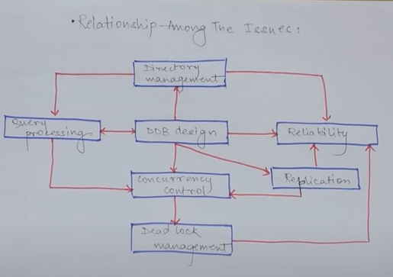

Slide 19
Design Issues of Distributed System
The distributed information system is defined as “a number of interdependent computers linked by a network for sharing information among them”. A distributed information system consists of multiple autonomous computers that communicate or exchange information through a computer network.
Design issues of distributed system –
Heterogeneity : Heterogeneity is applied to the network, computer hardware, operating system and implementation of different developers. A key component of the heterogeneous distributed system client-server environment is middleware. Middleware is a set of services that enables application and end-user to interacts with each other across a heterogeneous distributed system.
Openness: The openness of the distributed system is determined primarily by the degree to which new resource-sharing services can be made available to the users. Open systems are characterized by the fact that their key interfaces are published. It is based on a uniform communication mechanism and published interface for access to shared resources. It can be constructed from heterogeneous hardware and software.
Scalability: Scalability of the system should remain efficient even with a significant increase in the number of users and resources connected.
Security : Security of information system has three components Confidentially, integrity and availability. Encryption protects shared resources, keeps sensitive information secrets when transmitted.
Failure Handling: When some faults occur in hardware and the software program, it may produce incorrect results or they may stop before they have completed the intended computation so corrective measures should to implemented to handle this case. Failure handling is difficult in distributed systems because the failure is partial i, e, some components fail while others continue to function.
Concurrency: There is a possibility that several clients will attempt to access a shared resource at the same time. Multiple users make requests on the same resources, i.e read, write, and update. Each resource must be safe in a concurrent environment. Any object that represents a shared resource in a distributed system must ensure that it operates correctly in a concurrent environment.
Transparency : Transparency ensures that the distributes system should be perceived as a single entity by the users or the application programmers rather than the collection of autonomous systems, which is cooperating. The user should be unaware of where the services are located and the transferring from a local machine to a remote one should be transparent.

Slide 20
The design issues of Distributed Database
Distributed Database Design
• One of the main questions that is being addressed is how database and the applications that run against it should be placed across the sites.
• There are two basic alternatives to placing data: partitioned (or no-replicated) and replicated.
• In the partitioned scheme the database is divided into a number of disjoint partitions each of which is placed at different site. Replicated designs can be either fully replicated (also called fully duplicated) where entire database is stored at each site, or partially replicated (or partially duplicated) where each partition of the database is stored at more than one site, but not at all the sites.
• The two fundamental design issues are fragmentation, the separation of the database into partitions called fragments, and distribution, the optimum distribution of fragments. The research in this area mostly involve mathematical programming in order to minimize the combined cost of storing the database, processing transactions against it, and message communication among site.
Distributed Directory Management
• A directory contains information (such as descriptions and locations) about data items in the database. Problems related to directory management are similar in nature to the database placement problem discussed in the preceding section.
• A directory may be global to the entire DDBS or local to each site; it can be centralized at one site or distributed over several sites; there can be a single copy or multiple copies.
Distributed Query Processing
• Query processing deals with designing algorithms that analyze queries and convert them into a series of data manipulation operations. The problem is how to decide on a strategy for executing each query over the network in the most cost-effective way, however cost is defined.
• The factors to be considered are the distribution of data, communication cost, and lack of sufficient locally-available information. The objective is to optimize where the inherent parallelism is used to improve the performance of executing the transaction, subject to the abovementioned constraints.
Distributed Concurrency Control
• Concurrency control involves the synchronization of access to the distributed database, such that the integrity of the database is maintained. It is, without any doubt, one of the most extensively studied problems in the DDBS field.
• The concurrency control problem in a distributed context is somewhat different that in a centralized framework. One not only has to worry about the integrity of a single database, but also about the consistency of multiple copies of the database. The condition that requires all values of multiple copies of every data item to converge to the same value is called mutual consistency.
• Let us only mention that the two general classes are pessimistic, synchronizing the execution of the user request before the execution starts, and optimistic, executing requests and then checking if the execution has compromised the consistency of the database.
• Two fundamental primitives that can be used with both approaches are locking, which is based on the mutual exclusion of access to data items, and time-stamping, where transactions executions are ordered based on timestamps.
• There are variations of these schemes as well as hybrid algorithms that attempt to combine the two basic mechanisms.
Distributed Deadlock Management
• The deadlock problem in DDBSs is similar in nature to that encountered in operating systems.
• The competition among users for access to a set of resources (data, in this case) can result in a deadlock if the synchronization mechanism is based on locking. The well-known alternatives of prevention, avoidance, and detection/recovery also apply to DDBSs.
Reliability of Distributed DBMS
• It is important that mechanisms be provided to ensure the consistency of the database as well as to detect failures and recover from them. The implication for DDBSs is that when a failure occurs and various sites become either inoperable or inaccessible, the databases at the operational sites remain consistent and up to date.
• Furthermore, when the computer system or network recovers from the failure, the DDBSs should be able to recover and bring the databases at the failed sites up-to date. This may be especially difficult in the case of network partitioning, where the sites are divided into two or more groups with no communication among them.
Replication
• If the distributed database is (partially or fully) replicated, it is necessary to implement protocols that ensure the consistency of the replicas, i.e. copies of the same data item have the same value.
• These protocols can be eager in that they force the updates to be applied to all the replicas before the transactions completes, or they may be lazy so that the transactions updates one copy (called the master) from which updates are propagated to the others after the transaction completes.

Slide 21
Homogeneous Distributed Database System
In a homogeneous distributed database system, all sites have identical database management system software, are aware of one another, and agree to cooperate in processing users’ requests.
In such a system, local sites surrender a portion of their autonomy in terms of their right to change schemas or database-management system software.
That software must also cooperate with other sites in exchanging information about transactions, to make transaction processing possible across multiple sites.

Slide 22
Heterogeneous Distributed Database
In contrast, in a heterogeneous distributed database, different sites may use different schemas, and different database-management system software.
The sites may not be aware of one another, and they may provide only limited facilities for cooperation in transaction processing.
The differences in schemas are often a major problem for query processing, while the divergence in software becomes a hindrance for processing transactions that access multiple sites

Slide 23
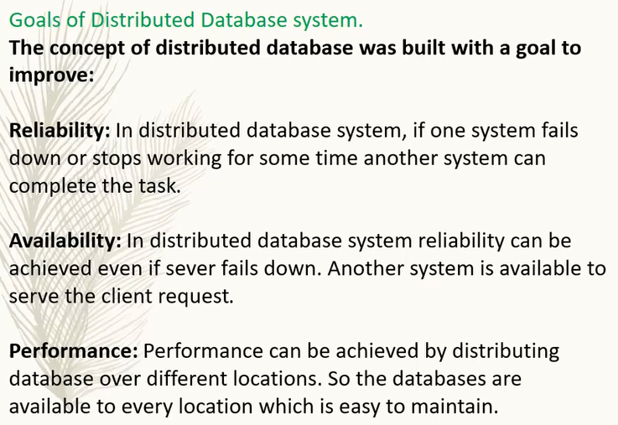

Slide 24
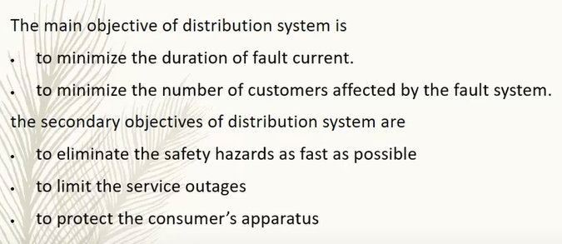

Slide 25
Distributed Data Storage
Consider a relation r that is to be stored in the database. There are two approaches to storing this relation in the distributed database:
Replication. The system maintains several identical replicas (copies) of the relation, and stores each replica at a different site. The alternative to replication is to store only one copy of relation r.
Fragmentation. The system partitions the relation into several fragments, and stores each fragment at a different site.
Fragmentation and replication can be combined: A relation can be partitioned into several fragments and there may be several replicas of each fragment.

Slide 26
Data Replication
If relation r is replicated, a copy of relation r is stored in two or more sites. In the most extreme case, we have full replication, in which a copy is stored in every site in the system.
There are a number of advantages and disadvantages to replication.
• Availability. If one of the sites containing relation r fails, then the relation r can be found in another site. Thus, the system can continue to process queries involving r, despite the failure of one site.
• Increased parallelism. In the case where the majority of accesses to the relation r result in only the reading of the relation, then several sites can process queries involving r in parallel. The more replicas of r there are, the greater the chance that the needed data will be found in the site where the transaction is executing. Hence, data replication minimizes movement of data between sites.

Slide 27
Increased overhead on update. The system must ensure that all replicas of a relation r are consistent; otherwise, erroneous computations may result. Thus, whenever r is updated, the update must be propagated to all sites containing replicas. The result is increased overhead. For example, in a banking system, where account information is replicated in various sites, it is necessary to ensure that the balance in a particular account agrees in all sites.
In general, replication enhances the performance of read operations and increases the availability of data to read-only transactions.
However, update transactions incur greater overhead. Controlling concurrent updates by several transactions to replicated data is more complex than in centralized systems.
We can simplify the management of replicas of relation r by choosing one of them as the primary copy of r.

Slide 28
Data Fragmentation
Fragmentation is a process of dividing the whole or full database into various sub tables or sub relations so that data can be stored in different systems. The small pieces of sub relations or sub tables are called fragments.
These fragments are called logical data units and are stored at various sites. It must be made sure that the fragments are such that they can be used to reconstruct the original relation (there isn’t any loss of data).
In the fragmentation process, If a table T is fragmented and is divided into a number of fragments say T1, T2, T3….TN. The fragments contain sufficient information to allow the restoration of the original table T.
This restoration can be done by the use of UNION or JOIN operation on various fragments. This process is called data fragmentation. All of these fragments are independent which means these fragments can not be derived from others.

Slide 29
Three methods for data fragmenting of a table
Horizontal fragmentation
Vertical fragmentation
Mixed or Hybrid fragmentation

Slide 30
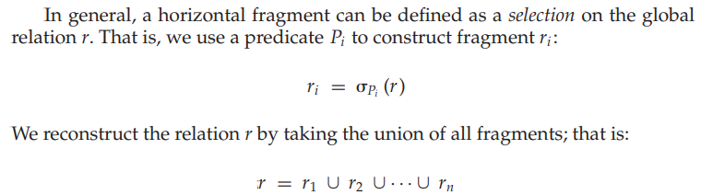
Horizontal fragmentation
Horizontal fragmentation refers to the process of dividing a table horizontally by assigning each row or (a group of rows) of relation to one or more fragments.
These fragments are then be assigned to different sides in the distributed system.
Some of the rows or tuples of the table are placed in one system and the rest are placed in other systems.
The rows that belong to the horizontal fragments are specified by a condition on one or more attributes of the relation.

Slide 31
Vertical Fragmentation
Vertical fragmentation refers to the process of decomposing a table vertically by attributes are columns. In this fragmentation, some of the attributes are stored in one system and the rest are stored in other systems.
This is because each site may not need all columns of a table. In order to take care of restoration, each fragment must contain the primary key field(s) in a table.
The fragmentation should be in such a manner that we can rebuild a table from the fragment by taking the natural JOIN operation and to make it possible we need to include a special attribute called Tuple-id to the schema.
For this purpose, a user can use any super key. And by this, the tuples or rows can be linked together.

Slide 32
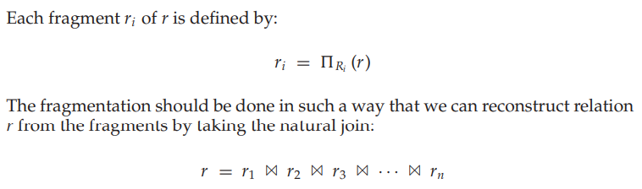

Slide 33
Mixed Fragmentation
The combination of vertical fragmentation of a table followed by further horizontal fragmentation of some fragments is called mixed or hybrid fragmentation.
For defining this type of fragmentation we use the SELECT and the PROJECT operations of relational algebra.
In some situations, the horizontal and the vertical fragmentation isn’t enough to distribute data for some applications and in that conditions, we need a fragmentation called a mixed fragmentation.

Slide 34
Advantages of Fragmentation:
As the data is stored close to the usage site, the efficiency of the database system will increase
Local query optimization methods are sufficient for some queries as the data is available locally
In order to maintain the security and privacy of the database system, fragmentation is advantageous
Disadvantages of Fragmentation :
Access speeds may be very high if data from different fragments are needed
If we are using recursive fragmentation, then it will be very expensive

Slide 35
What is Transparency?
The user of a distributed database system should not be required to know where the data are physically located nor how the data can be accessed at the specific local site. This characteristic, called data transparency.
Transparency in DDBMS refers to the transparent distribution of information to the user from the system. It helps in hiding the information that is to be implemented by the user.
For example, in a normal DBMS, data independence is a form of transparency that helps in hiding changes in the definition & organization of the data from the user.
But, they all have the same overall target. That means to make use of the distributed database the same as a centralized database.

Slide 36
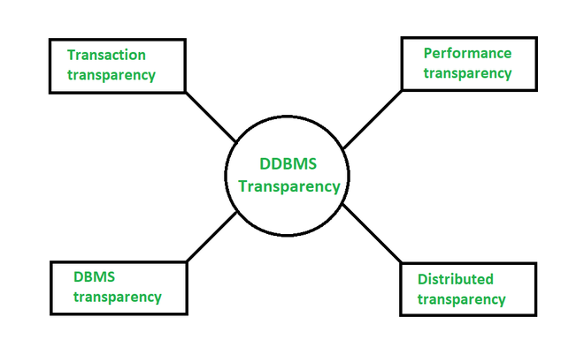
Transparencies in DDBMS
In Distributed Database Management System, there are four types of transparencies,
Transaction transparency
Performance transparency
DBMS transparency
Distribution transparency

Slide 37
1. Transaction transparency-
This transparency makes sure that all the transactions that are distributed preserve distributed database integrity and regularity.
Also, it is to understand that distribution transaction access is the data stored at multiple locations.
The DDBMS is responsible for maintaining the atomicity of every sub-transaction (By this, we mean that either the whole transaction takes place directly or doesn’t happen in the least).
It is very complex due to the use of fragmentation, allocation, and replication structure of DBMS.

Slide 38
2. Performance transparency-
This transparency requires a DDBMS to work in a way that if it is a centralized database management system.
Also, the system should not undergo any downs in performance as its architecture is distributed.
Likewise, a DDBMS must have a distributed query processor which can map a data request into an ordered sequence of operations on the local database.
This has another complexity to take under consideration which is the fragmentation, replication, and allocation structure of DBMS.

Slide 39
3. DBMS transparency-
This transparency is only applicable to heterogeneous types of DDBMS (Databases that have different sites and use different operating systems, products, and data models) as it hides the fact that the local DBMS may be different.
This transparency is one of the most complicated transparencies to make use of as a generalization.

Slide 40
4. Distribution transparency- (Data organization transparency or network transparency)
Distribution transparency helps the user to recognize the database as a single thing or a logical entity, and if a DDBMS displays distribution data transparency, then the user does not need to know that the data is fragmented.
Distribution transparency has its 5 types,
Fragmentation transparency
Location transparency
Replication transparency
Local mapping transparency
Naming transparency

Slide 41
Fragmentation transparency-
Users are not required to know how a relation has been fragmented
User unaware of data fragmentation and work on global relations.
Enables user to query upon any table as if its were unfragmented
In this type of transparency, the user doesn’t have to know about fragmented data and, due to which, it leads to the reason why database accesses are based on the global schema.
This is almost somewhat like users of SQL views, where the user might not know that they’re employing a view of a table rather than the table itself.

Slide 42
Location transparency-
Users are not required to know the physical location of the data.
If this type of transparency is provided by DDBMS, then it is necessary for the user to know how the data has been fragmented, but knowing the location of the data is not necessary.
The distributed database system should be able to find any data as long as the data identifier is supplied by the user transaction.
Location transparency refers to the fact that the command used to perform a task is independent of the location of the data and the location of the node where the command was issued.

Slide 43
Replication transparency-
Users view each data object as logically unique. The distributed system may replicate an object to increase either system performance or data availability. Users do not have to be concerned with what data objects have been replicated, or where replicas have been placed.
The user does not know about the copying of fragments (user unaware of existence of multiple copies of data at different sites).
Replication transparency is related to concurrency transparency and failure transparency. Whenever a user modifies a data item, the update is reflected altogether in the copies of the table. However, this operation shouldn’t be known to the user.

Slide 44
Local Mapping transparency-
In local mapping transparency, the user needs to define both the fragment names, location of data items while taking into account any duplications that may exist.
This is a more difficult and time-taking query for the user in DDBMS transparency.
It refers to the fact that user is aware of both fragment names and location of fragments, taking into account that any replication of the fragments may exists.

Slide 45
Naming transparency-
We already know that DBMS and DDBMS are types of centralized database system.
It means that each item in this database (relation, fragment, replicas) must consist of a unique name.
It further means that DDBMS must make sure that no two sites are creating a database object with the same name.
So to solve the problem of naming transparency, there are two ways, either we can create a central name server to create the unique names of objects in the system, or, differently, is to add an object starting with the identifier of the creator site.

